Slide 1
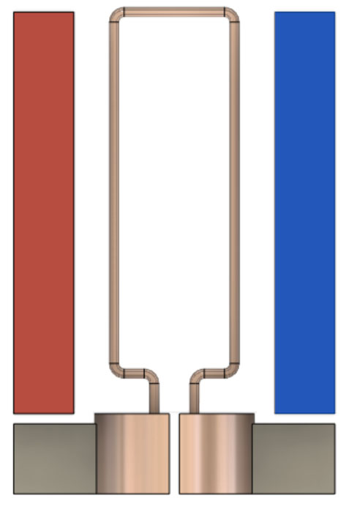
Magnet
Magnet
Armature
-
+
Commutator

